Slide 1

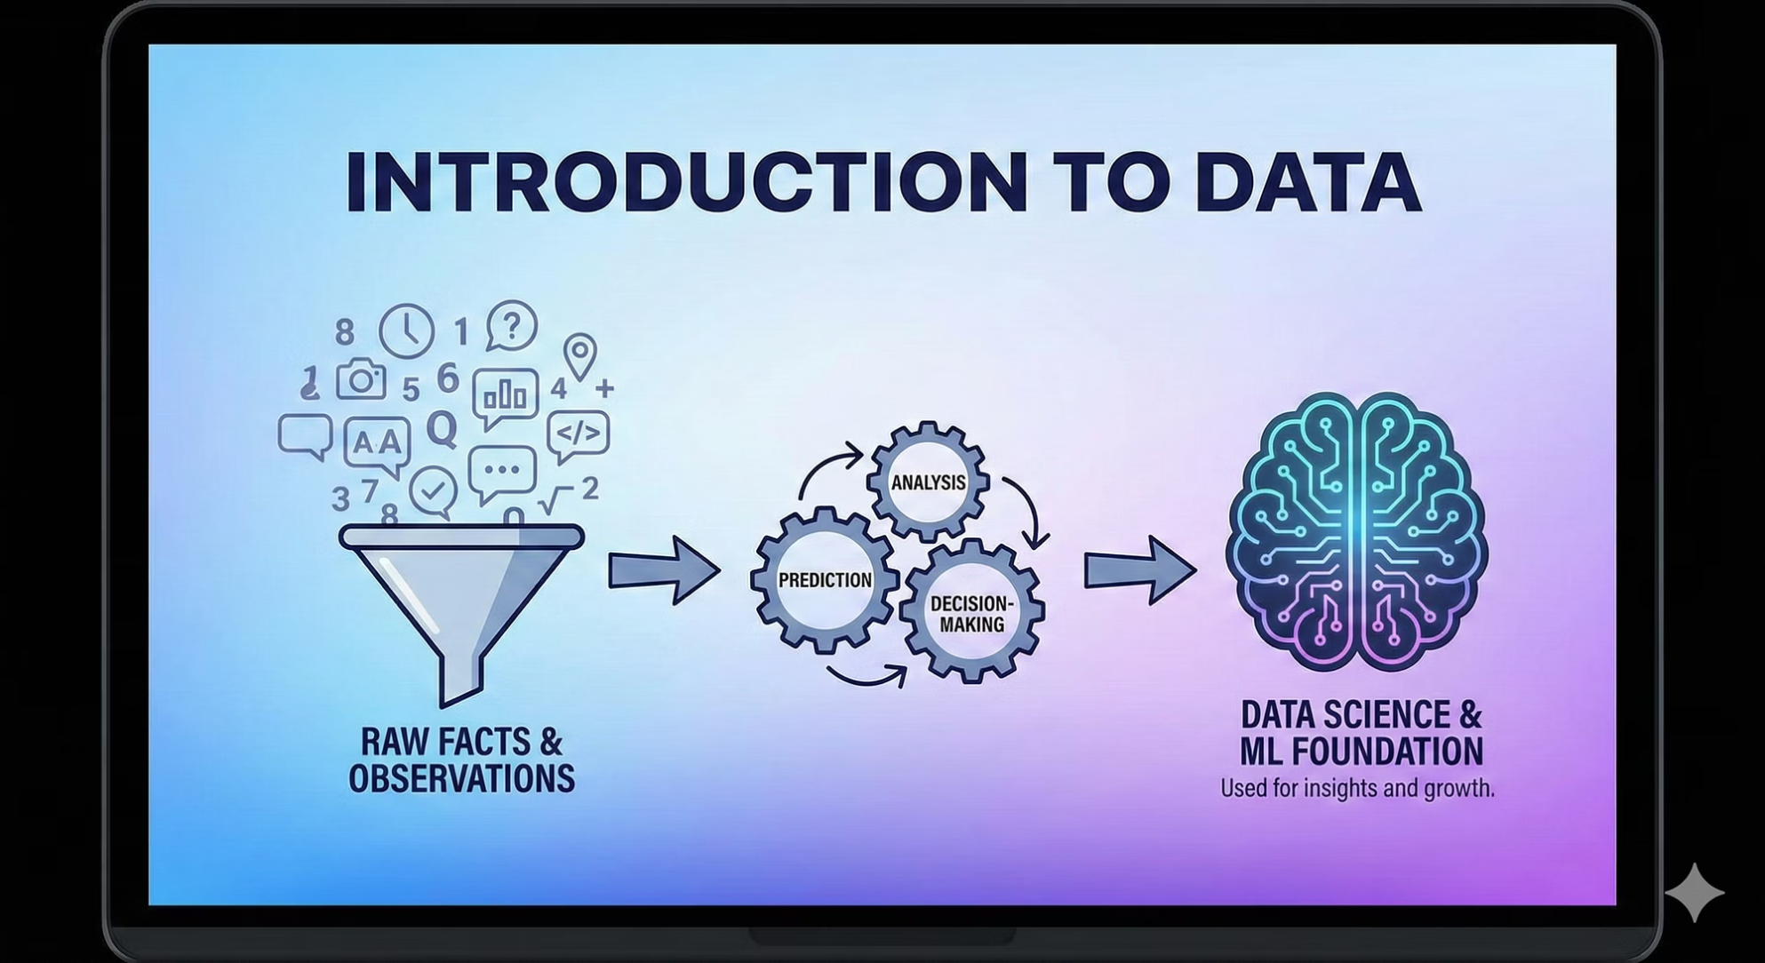
The Foundations of Data: An Essential Guide
Welcome to an introduction to the fundamental concepts of data. This presentation will guide you through the essentials of data, its types, patterns, and how it forms the backbone of modern analytics and machine learning.
Presented By- Jiya Chaudhary
RA2311003030560
BTECH CSE CORE I

Slide 2

Understanding Data: Raw Facts and Insights
1
2
3
Raw Facts and Observations
Fuel for Analysis and Prediction
Pillar of Data Science & ML
At its core, data comprises unprocessed facts, figures, and observations collected from various sources. It is the unfiltered material awaiting interpretation.
Data serves as the fundamental building block for the fields of Data Science and Machine Learning, driving innovations and understanding in complex systems.
Data is the essential ingredient for analytical processes, enabling us to uncover hidden insights, forecast future trends, and make informed decisions.

Slide 3

Diverse Data Forms: Structured, Semi-Structured, Unstructured
Structured Data
Semi-Structured Data
Organised in a fixed format, typically found in tables, relational databases, and spreadsheets, making it easily searchable and quantifiable.
Possesses some organisational properties but doesn't conform to a rigid relational database structure, such as JSON or XML files.
Unstructured Data
Lacks a predefined data model and is often in formats like text documents, images, audio, and video, making it challenging to process and analyse.

Slide 4
Uncovering Hidden Relationships: Kinds of Data Patterns
Association
1
Discovering relationships and correlations between items within large datasets.
Sequential
2
Identifying patterns that occur in a specific order over a period of time.
Classification
3
Categorising data points into predefined classes or groups.
Clustering
4
Grouping similar data points together based on their inherent characteristics.
Anomaly
5
Detecting unusual data points or events that deviate significantly from the norm.

Slide 5
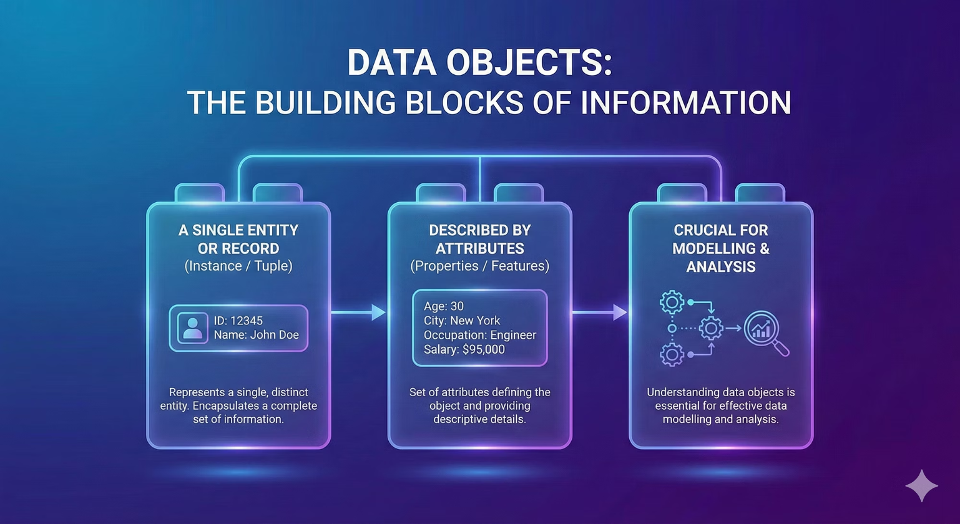

Data Objects: The Building Blocks of Information
A Single Entity or Record
A data object, often referred to as an instance or tuple, represents a single, distinct entity within a dataset. Each object encapsulates a complete set of information about one particular item.
Described by Attributes
Every data object is characterised by a set of attributes. These attributes are the properties or features that define the object and provide descriptive details about it.
Understanding data objects is crucial for effective data modelling and analysis.

Slide 6
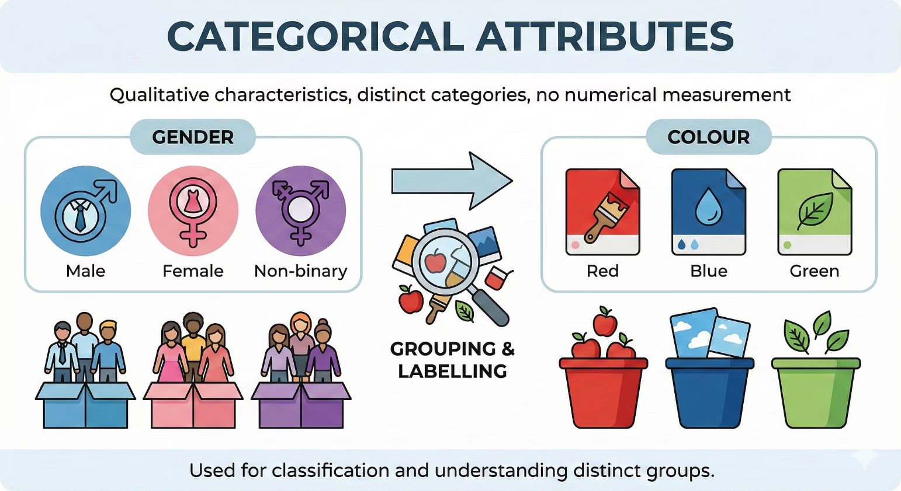
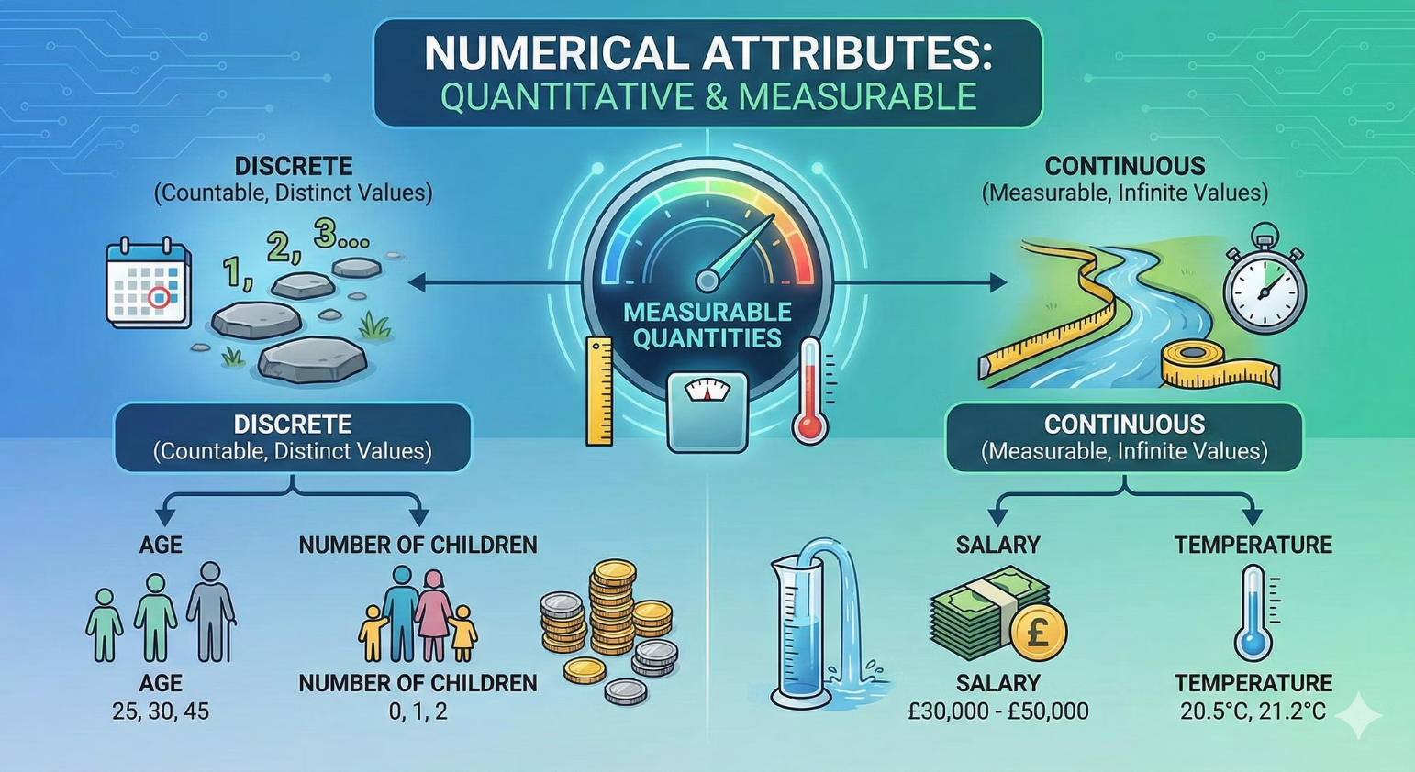
Attribute Types: Categorical vs. Numerical
Categorical Attributes
Numerical Attributes
These attributes represent qualitative characteristics and fall into distinct categories or labels. They cannot be measured numerically but can be grouped. Examples include Gender (Male, Female, Non-binary) or Colour (Red, Blue, Green).
Numerical attributes are quantitative and can be measured on a numerical scale. They represent measurable quantities and can be further classified as discrete or continuous. Examples include Age (25, 30, 45) or Salary (£30,000, £50,000).

Slide 7
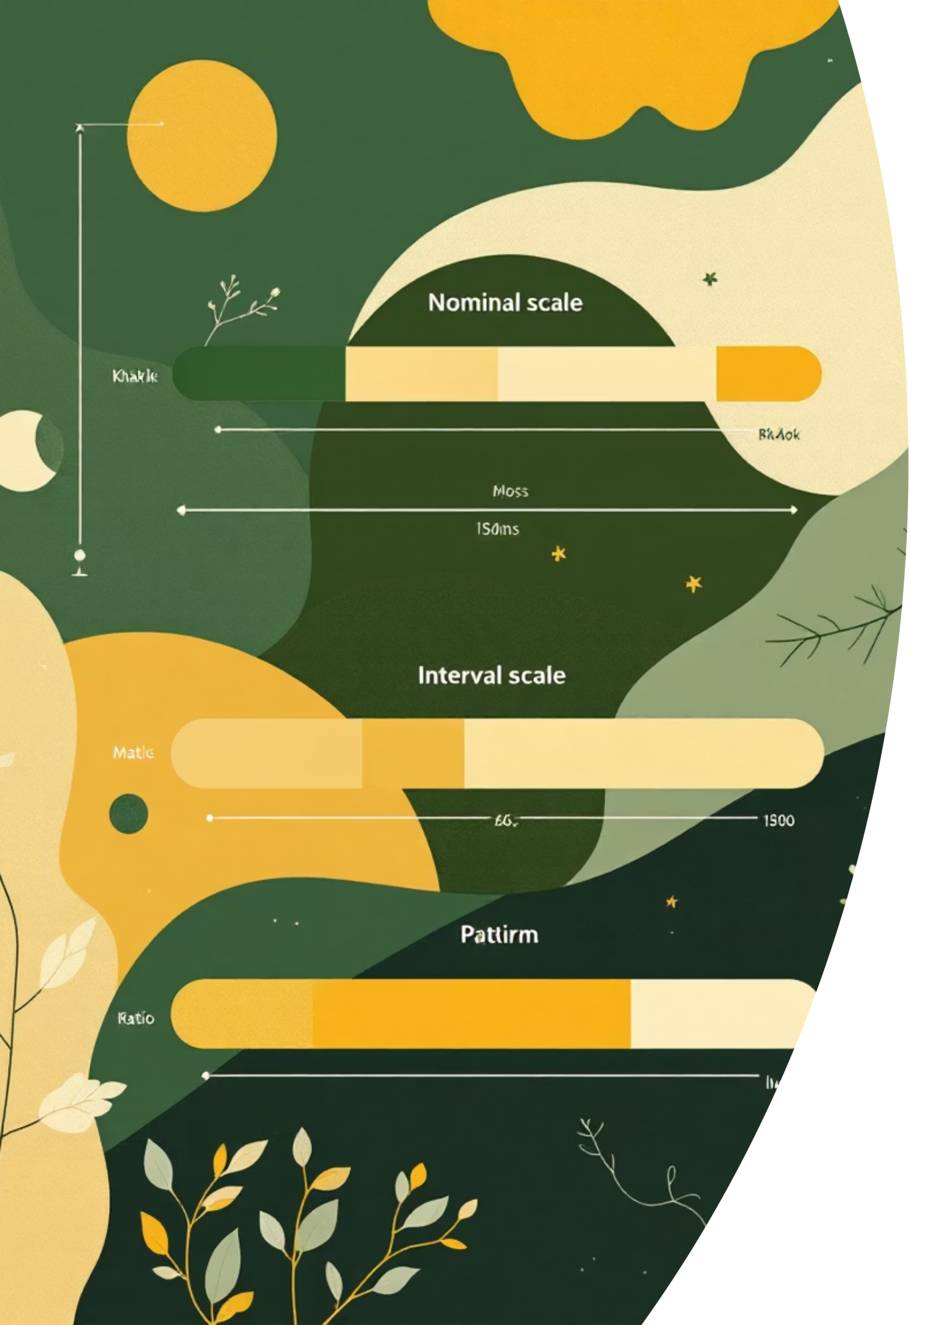




Measurement Scales: Quantifying Data Precisely
Nominal Scale
Data is categorised without any order or hierarchy. Labels are used for identification, and there's no quantitative value or ranking. (e.g., Marital Status, City of Birth)
Ordinal Scale
Categories have a meaningful order, but the intervals between them are not necessarily equal. (e.g., Educational Level: High School, Bachelor's, Master's, PhD)
Interval Scale
Data has a definite order, and the intervals between values are equal, but there's no true zero point. (e.g., Temperature in Celsius/Fahrenheit, Dates)
Ratio Scale
Possesses all the characteristics of an interval scale but includes a true zero point, allowing for meaningful ratios. (e.g., Height, Weight, Income)

Slide 8
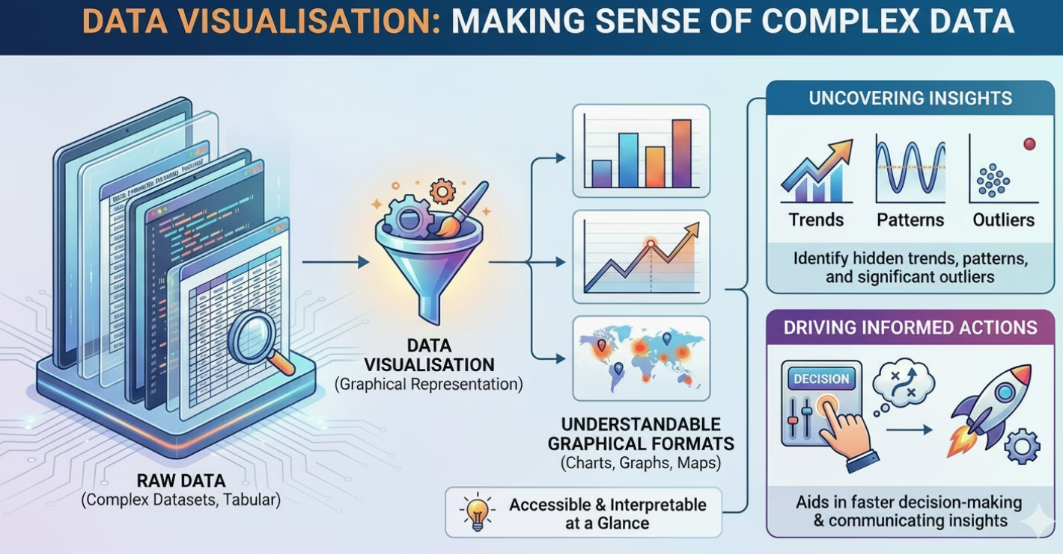
Data Visualisation: Making Sense of Complex Data
Graphical Representation of Data
Data visualisation transforms raw data into understandable graphical formats such as charts, graphs, and maps. This makes complex datasets accessible and interpretable at a glance.
Uncovering Trends, Patterns, and Outliers
By presenting data visually, we can quickly identify underlying trends, recurring patterns, and significant outliers that might otherwise remain hidden in tabular data, aiding in faster decision-making.
Effective data visualisation is crucial for communicating insights and driving informed actions across various fields.

Slide 9





Key Visualisation Tools for Data Exploration
Bar Chart
Line Chart
Pie Chart
Ideal for comparing different categories or tracking changes over time with discrete data points.
Perfect for displaying trends and changes in data over a continuous period, showing progression.
Used to illustrate proportions and percentages of a whole, showing how categories contribute to a total.
Histogram
Scatter Plot
Represents the distribution of numerical data, showing frequency of data within specific intervals.
Displays the relationship between two numerical variables, identifying correlations and clusters.

Slide 10




Data Mining: Extracting Insights from Raw Data
Data mining is the process of discovering patterns, trends, and valuable knowledge from large datasets using a combination of machine learning, statistics, and database systems. Its primary goal is to transform raw data into actionable intelligence.
Key Data Mining Techniques
Classification
Clustering
Assigns data points to predefined categories based on learned patterns from labeled data (e.g., spam detection, customer churn prediction).
Groups similar data points together into clusters, without prior knowledge of group definitions, to identify inherent structures (e.g., market segmentation, anomaly detection).
Regression
Association Rules
Predicts a continuous numerical value based on the relationship between variables (e.g., sales forecasting, house price prediction).
Discovers interesting relationships or correlations between items in large datasets (e.g., "market basket analysis" to identify products frequently bought together).

Slide 11


